Slide 1
ENSURING ACCESS TO PRIMARY CARE FOR UNDOCUMENTED MIGRANTS IN ENGLAND
Yusef Azad
Director of Strategy,
AIDS 2018, Amsterdam

Slide 2
DECLARATION OF INTERESTS
NAT (National AIDS Trust) has received funding in the last 12 months from Gilead, Janssen, MSD, Mundi Pharma and ViiV.
Yusef Azad sits in a personal capacity as a patient and public voice representative on NHS England’s Programme of Care Board for Blood and Infection.

Slide 3
OVERVIEW
Background on migrants and HIV in UK
Background on the NHS and charging
The 2015 consultation on charging in primary care
Factors in successful resistance
Conclusions

Slide 4
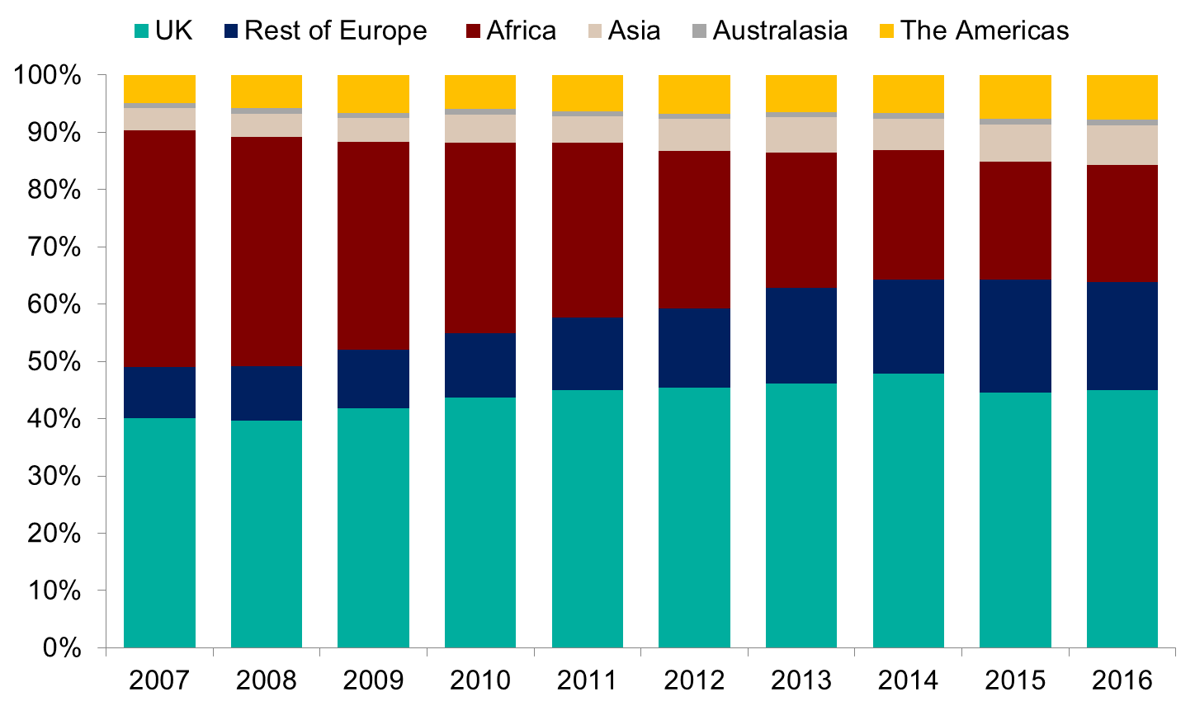
Proportion of people newly diagnosed with HIV by world region of birth: United Kingdom, 2007 to 2016
Excludes people with missing country of birth information
Notes:
55% of all people in HIV care in the UK were born abroad
… and 55% of people newly diagnosed with HIV in 2016 were born abroad
So migrant health has been and continues to be a ‘majority issue’ for the HIV sector
You will see though from this PHE graph that over the years the make up of the migrant cohort has changed significantly, with the proportion from sub-Saharan Africa decreasing over the last decade and the proportions from other world regions such as Europe, Asia and the Americas increasing. We are seeing an increasingly heterogeneous migrant population in HIV care
Hets in 2016 65% were migrants of the newly diagnosed
MSM in 2016 47% were migrants of the newly diagnosed

Slide 5
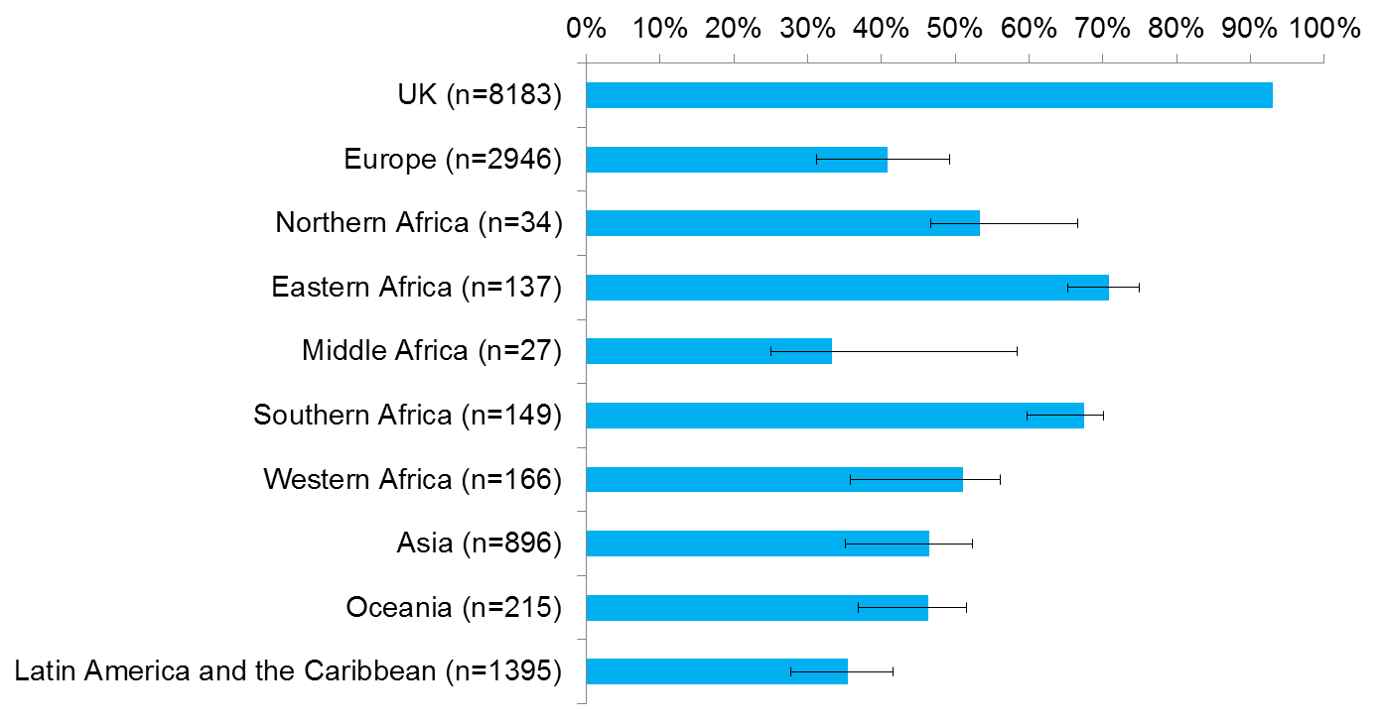
Estimated proportion of gay/bisexual men who probably acquired HIV in the UK, by country of birth: diagnosed between 2012-2016
Notes:
I want to think about testing in more detail but a final slide makes the point that a high proportion of migrants acquire HIV in the UK post-migration – this slide just looks at MSM migrants but it’s equally true of heterosexual migrants - here it’s striking to see for example over 50% of Eastern and South African MSM getting HIV post-migration – which only underlines the need for newly arrived communities to receive effective HIV prevention interventions.

Slide 6
THE NHS AND PRIMARY CARE
NHS (National Health Service): funded by general taxation and provides healthcare free at point of delivery
Separately organised NHS systems in the four nations comprising the UK
General Practice (part of primary care): vast majority of NHS consultations (c. 340 million each year). It is the gatekeeper for most hospital care
Primary care also includes: NHS prescriptions, dental care and ophthalmic services

Slide 7
CHARGING FOR NHS SECONDARY CARE
Most secondary care is not free for: visa overstayers, refused asylum seekers, unlawful entrants and UK expatriates
Exceptions: ‘emergency care’ and infectious diseases (incl. HIV treatment) are free for all
Primary care remains free for all irrespective of residency status
Notes:
NHS is free for most people but secondary/hospital care not free – there is a charge – for some groups. Some elements of hospital care however are exempted and do not charge whatever your residency status including emergency care and care for infectious diseases (though not always true for HIV – an NAT policy victory in 2011).

Slide 8
REPEATED ATTEMPTS TO
CHARGE IN PRIMARY CARE
Government: repeated consultations on charging regulations (e.g. in 2007, 2013 and 2015) (just like repeated amendments to immigration law).
Consultations have include proposals to charge for primary care.
NAT and allies: repeatedly oppose the Government on primary care, so far successfully, arguing charges will deter migrants from a key setting for infectious disease diagnosis
Notes:
Govt constantly proposing to extend charges to primary care

Slide 9
2015 CONSULTATION
Department of Health (DH) consultation opened Nov 2015. ‘Making a fair contribution’ proposed:
Charging for primary medical care treatment, but with consultations and testing for infectious diseases, including HIV, remaining free
But why go to GP if no affordable treatment available? And people tend not to go to GP seeking a specific test. They come with symptoms – the GP recommends a test as part of the differential diagnosis
Notes:
Only look at the most recent consultation but in most important ways our response was similar to previous consultations

Slide 10
2015 CONSULTATION
“We have previously committed to keeping all GP and nurse consultations free for all. This is on public protection grounds, as early identification of diseases such as TB and Ebola will help prevent or lessen the risk of any potential outbreaks. We do not want a situation to arise where the health of the public is put at risk because someone is deterred from seeking diagnosis because they are worried about being charged to see a GP. We intend to uphold that commitment and maintain consultations in primary care as free at the point of use.”
Notes:
In this passage the Govt cites TB and Ebola as examples re infectious disease concerns – at the time of the actual previous consultation they foregrounded HIV.
Claim to address the concern through consultations remaining free even if any treatment is charged for

Slide 11
CONSULTATION: GALVANISING OPPOSITION
Secured engagement from clinicians: British HIV Association (BHIVA), British Medical Association (BMA), Medical Royal Colleges and Doctors of the World (DOTW), who were a key partner
Sourced case studies demonstrating harm of charging (DOTW)
Drafted a briefing paper and template consultation responses supporting other organisations to respond (through the Entitlement Working Group)
Engaged with Department of Health via Equalities and Vulnerable Peoples Representatives Group
Engaged with the media (e.g. BMJ, Lancet) and with parliament
Notes:
Moral power of the doctor’s voice
Persuasive power of the concrete human experience
Power in numbers
Leverage the equality, health inequalities and human rights duties – public bodies have a legal obligation to consider how any policy impacts on equality considerations
Ongoing media work in medical press and engaging parliamentarians

Slide 12
CONSULTATION: GOVERNMENT RESPONSE
Delayed to April 2017. Government:
Noted public health arguments re. infectious disease,
Noted concerns re. cost-effectiveness and administrative burden,
Acknowledged ‘challenges’ to charging in primary care but believes it has ‘an important role’ both in establishing chargeable status and in charging itself
Decided to take a phased approach over longer timescale
Notes:
Response delayed by General Election and other priorities
In relation to primary care, ‘dignified retreat’

Slide 13
CURRENT STATE OF PLAY
Government enacted regulations in 2017 based on consultation – there was no attempt to charge in primary care
Voluntary process for GPs to ask about chargeability status on registration (do we need to push back as possible precursor to charging in primary care?)
No immediate plans from Govt to move to primary care charging

Slide 14
FACTORS IN SUCCESS
Quality of surveillance data
Independent and helpful national public health body – Public Health England (PHE)
We have data showing if born overseas, when arrived in UK and when diagnosed (though not on detail of migration status e.g undocumented) - can counter ‘health tourism’ claims
Data on where migrants test and are diagnosed with HIV – shows value of primary care access
Data on CD4 count at diagnosis – shows problem of late diagnosis & rates of post-entry HIV acquisition
Notes:
We have data on migrants! Been crucial to effective response to these proposals – collected by a body which protects confidentiality and which is committed to their health and welfare. But doesn’t ask for migration status – too sensitive
Data on timing of migration helps show people don’t come to access HIV services – average 4.5 yr gap between arrival and diagnosis
Recent PHE study bl Af men 12% and bl Af women 13% diagnosed in primary care ion 2014 – and % increasing over time. Shows value of primary care access. S Croxford et al ‘Where do we diagnose HIV infection? Monitoring new diagnoses made in non-traditional settings in England, Wales and Northern Ireland’ HIV Medicine (2018)
CD4 count at diagnosis not only shows health inequality of much higher late diagnosis among heterosexual migrants (53% v 42%, going up to 65% bl Af men), but also through back calculation PHE estimates % of migrants who are acquiring HIV after arrival here – emphasises prevention needs in this population and need to test and treat as part of an effective response

Slide 15
FACTORS IN SUCCESS
Quality of research data
Sigma Research (www.sigmaresearch.org.uk) African Health & Sex Survey
Positive Voices (www.ucl.ac.uk/voices)
Stigma Index (UK) (www.stigmaindexuk.org)
Latter two weighted representative samples of people living with HIV – useful data re. experiences of primary care, testing and stigma
Notes:
Also research data e.g of African communities (not only living with HIV) with primary care most popular site for future HIV testing
Pos Voices and Stigma Index both rep samples of people living with HIV

Slide 16
FACTORS IN SUCCESS
Coalition building
An effective Entitlement Working Group – made up of health and migrant charities, doctors and lawyers
Support from Doctors and credible medical organisations, e.g. consultation submissions and actions from British HIV Association (BHIVA) and British Medical Association (BMA) etc
Support within parliament e.g. MPs asking questions and engagement through All Party Parliamentary Group on HIV and AIDS and parliamentary committees
Notes:
Successful engagement with opposition party – Regret motion tabled in the Lords as a result and briefed for debate – Govt Formal review of Regs with specific focus on effect on vuln groups and public health

Slide 17
FACTORS IN SUCCESS
Strong policy arguments!
Public health - centrality of Treatment as Prevention to HIV response
Public health - diagnosis of other infectious diseases, esp. TB... and now Ebola
Costs of late diagnosis - onward transmission, morbidity and mortality
Costs of administration of charges in primary care setting
Human rights and equality obligations

Slide 18
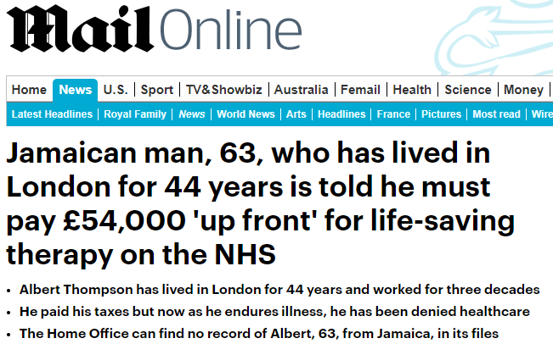
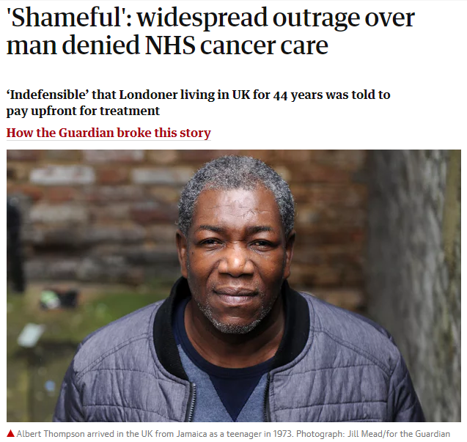
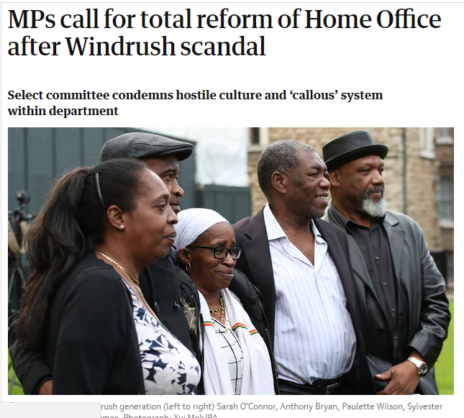
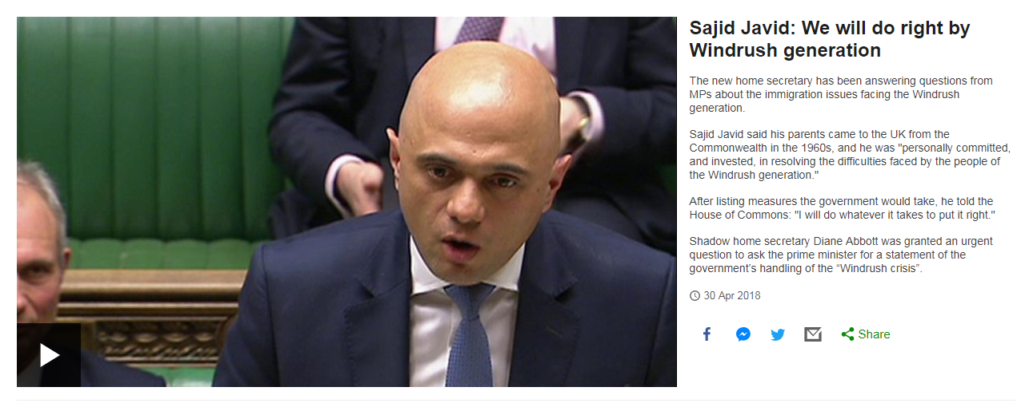
EMERGING SUPPORT FOR MIGRANTS?
THE WINDRUSH SCANDAL

Slide 19
CONCLUSIONS
Policy success is often about stopping bad things happening, maintaining the status quo
Success to date should not result in complacency – there will be further attempts, depending on political climate
We need to be proactive in developing case against charging in primary care, capitalise on Windrush scandal, argue against collection of chargeability status by GPs
Can other countries with harsher rules ‘level up’ to UK practice?

Slide 20
THANK YOU
For more information:
www.nat.org.uk
yusef.azad@nat.org.uk

